Slide 1
Non-i.i.d sample classification challenge
陈旭鹏，徐天行，张文源，陈俣策

Slide 2
Contents
Data analysis
Basic classification
Other models tried
Some thoughts

Slide 3
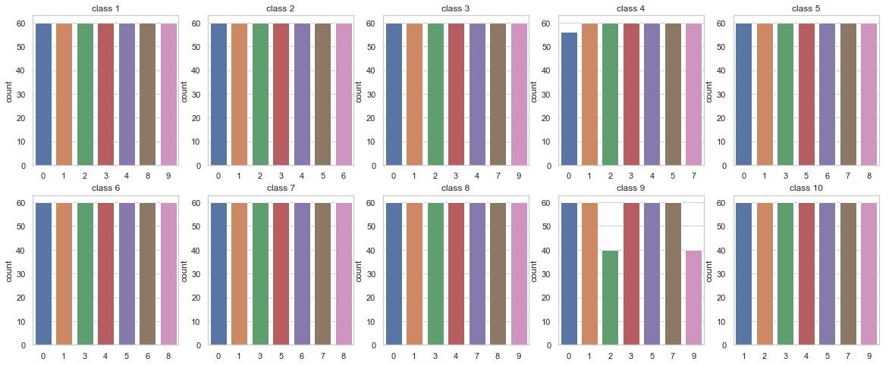
Visualize class and context

Slide 4
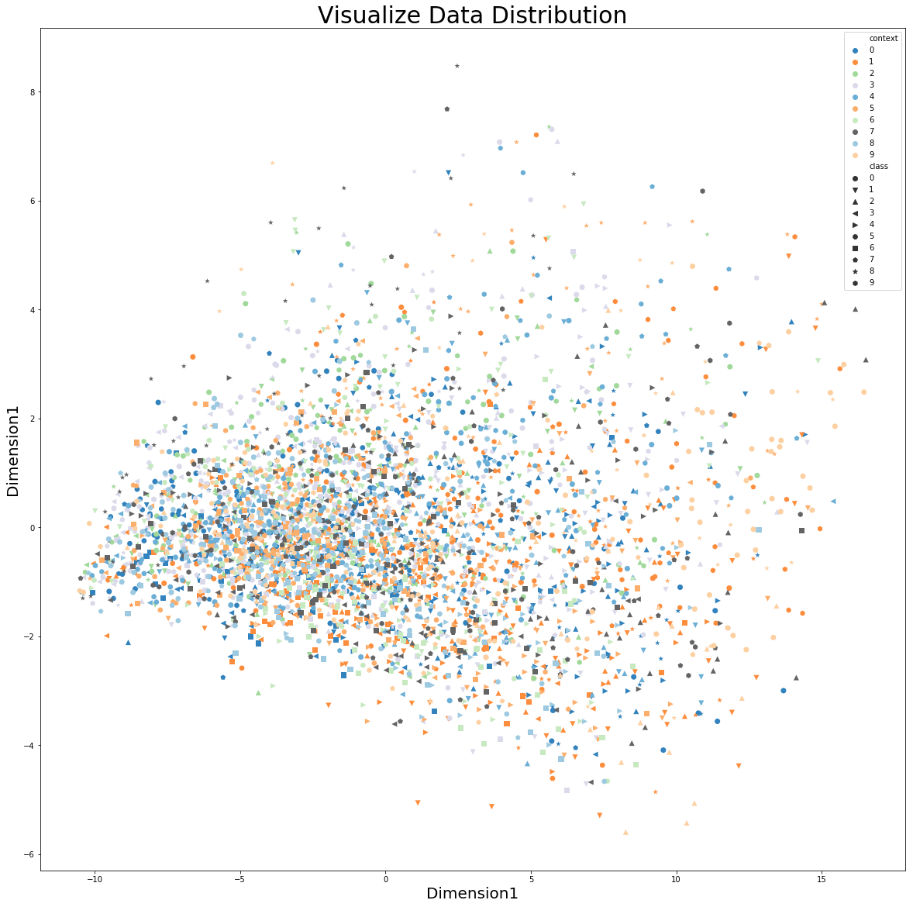
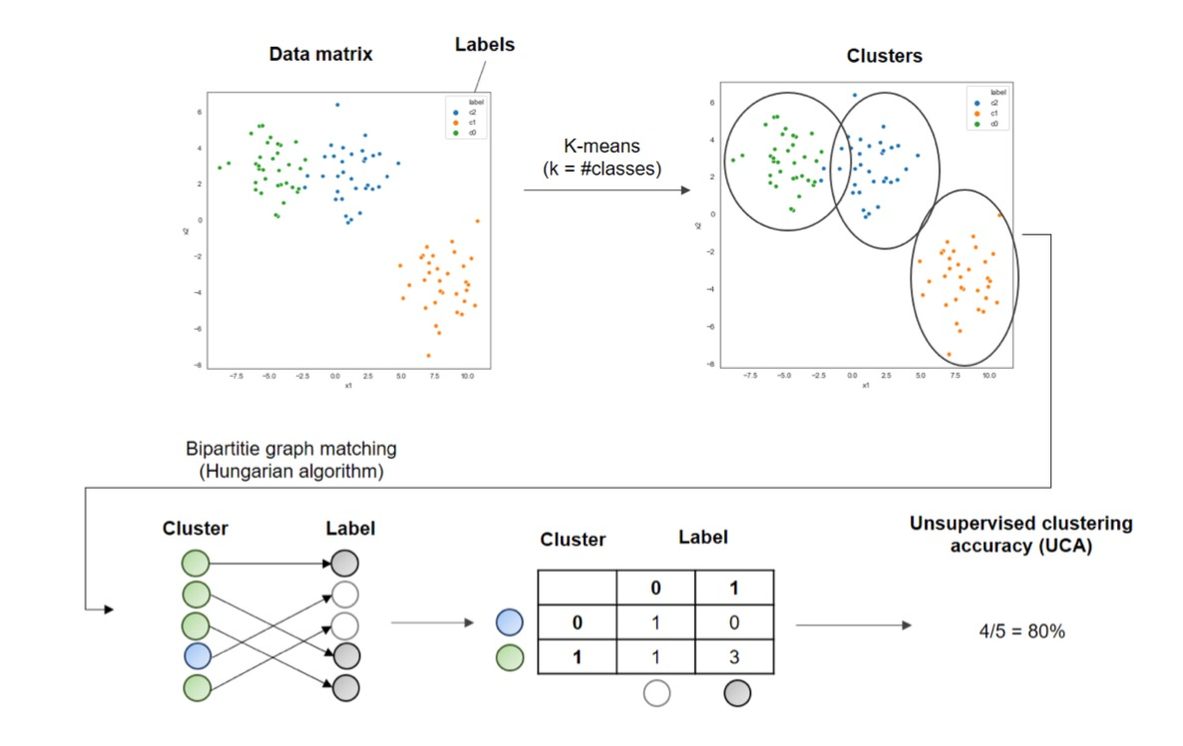
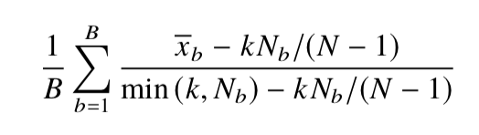
Visualize Sample distribution
UCA score: 0.157
1-mKNN score: 0.96 (samples are not
clustered according to context)

Slide 5
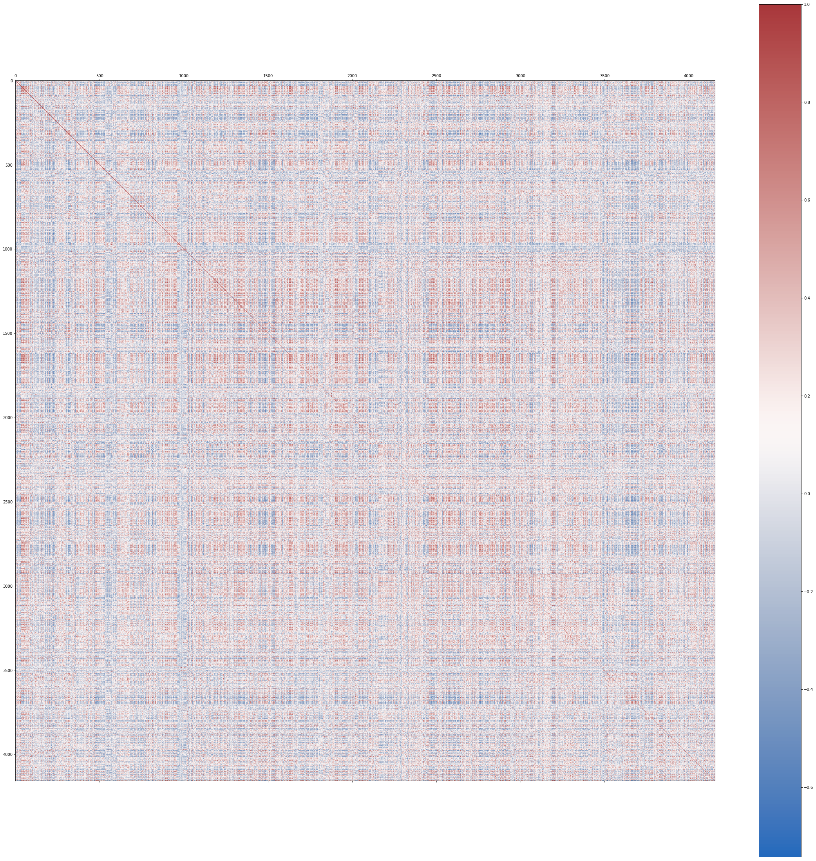
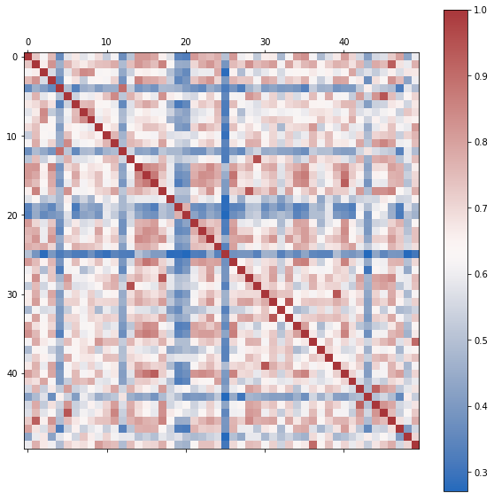
No significant feature or sample correlation patterns

Slide 6
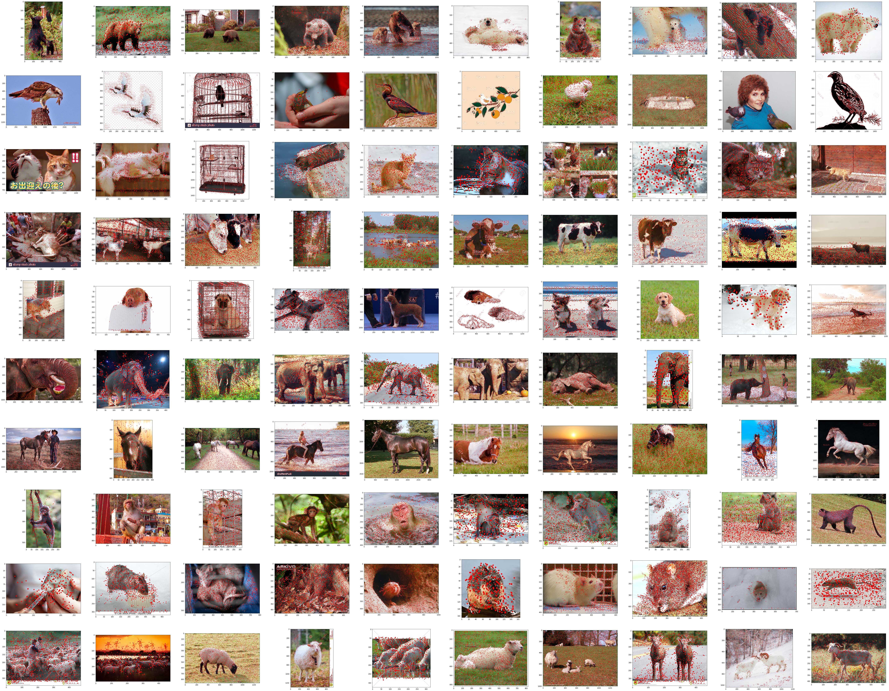
SURF extracted features

Slide 7
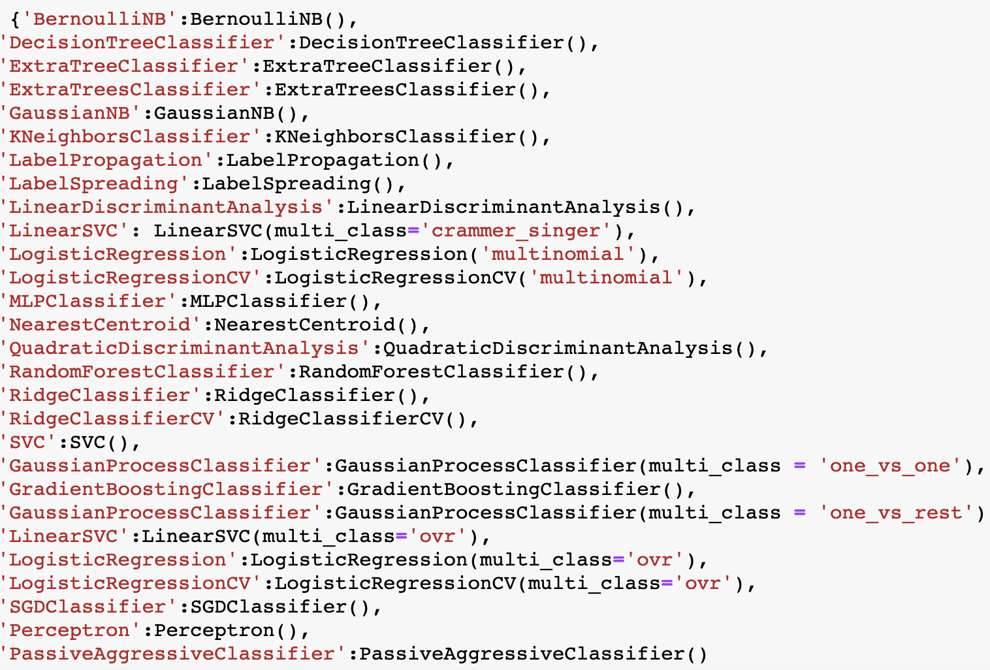
Basic classification
5-fold classification results
6 contexts for training, 1 context for test

Slide 8
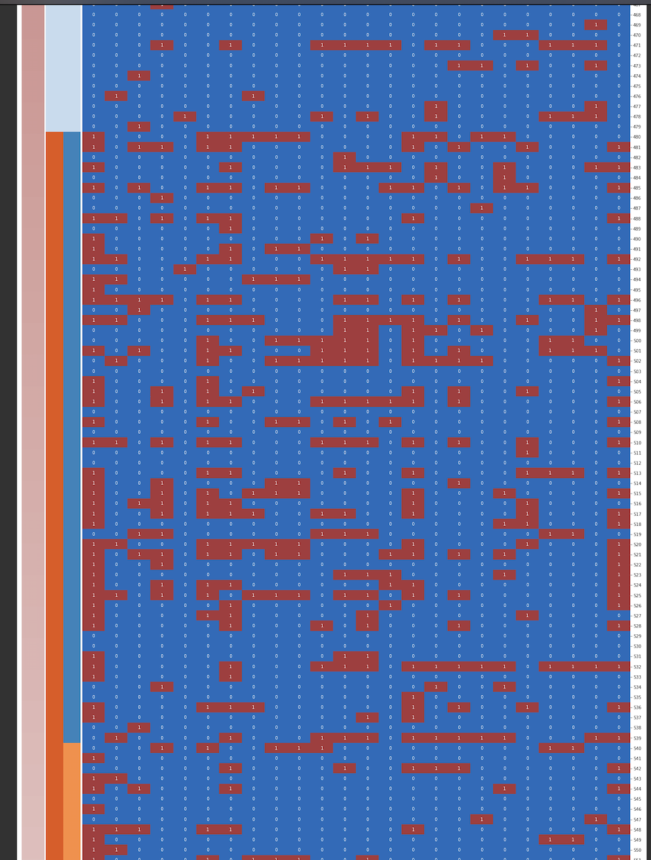
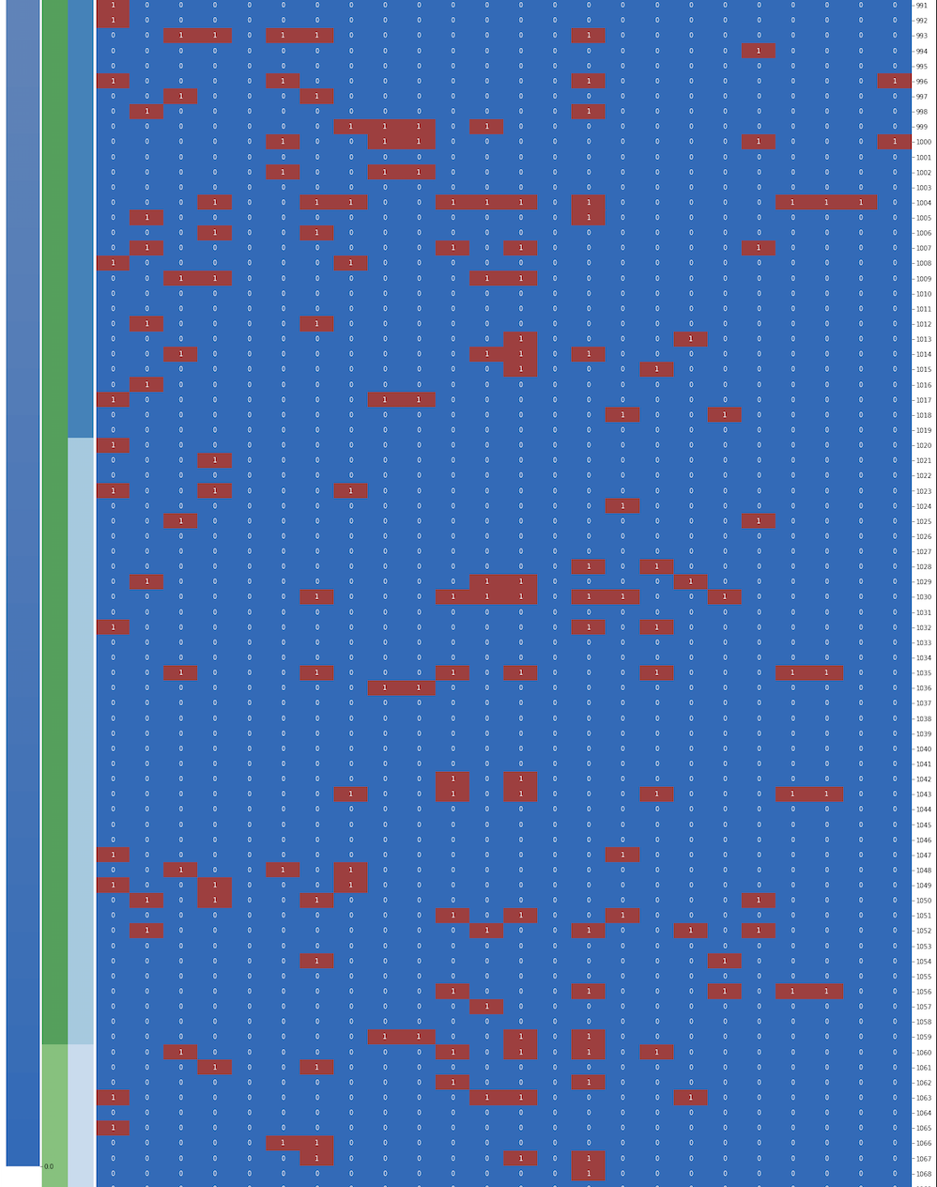
Summary of basic classification
Some class are hard to predict

Slide 9
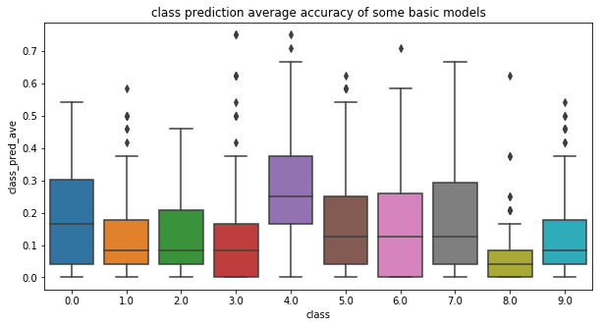
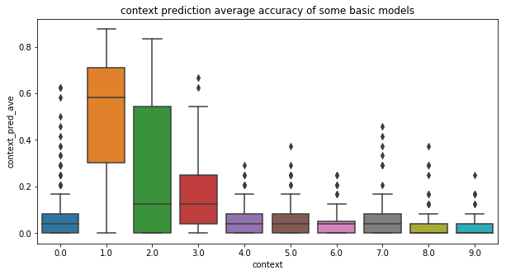
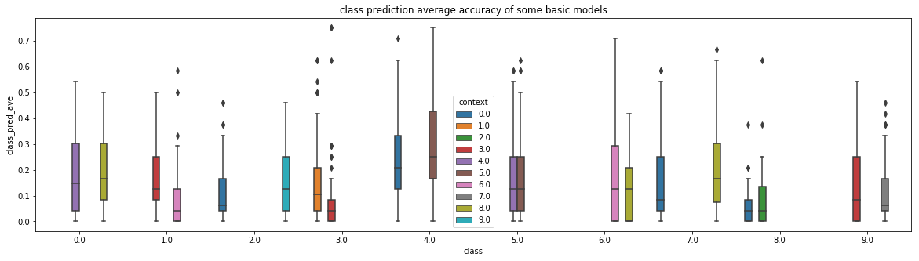
Average accuracy of some basic classifiers

Slide 10
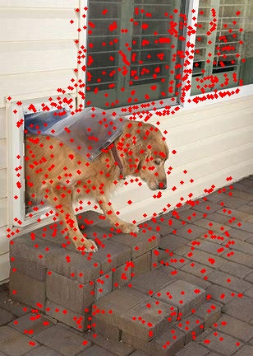
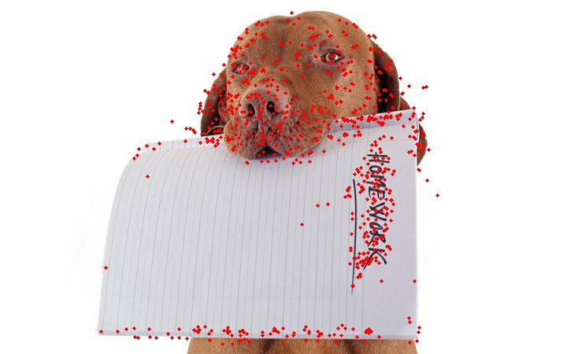
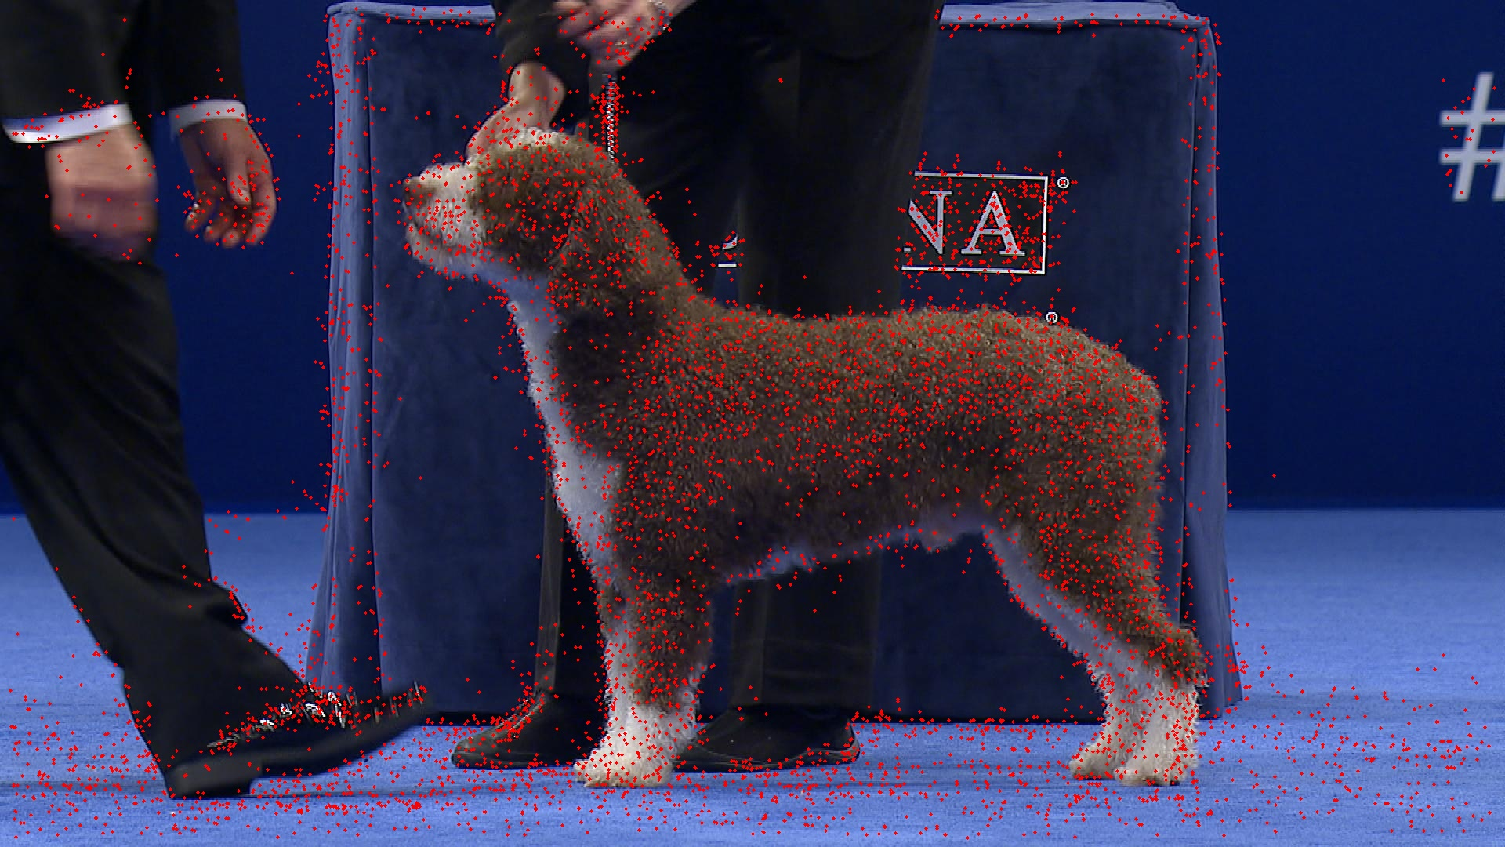
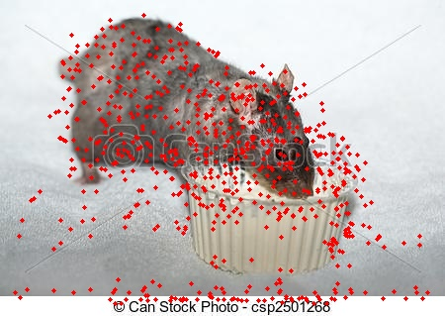
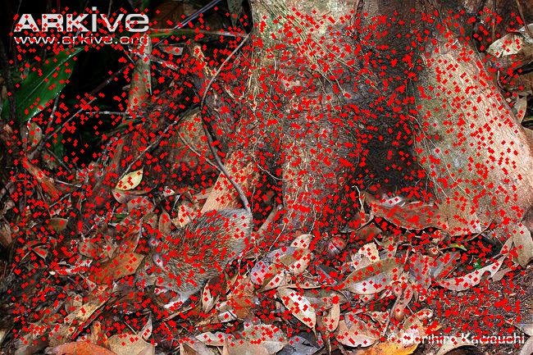
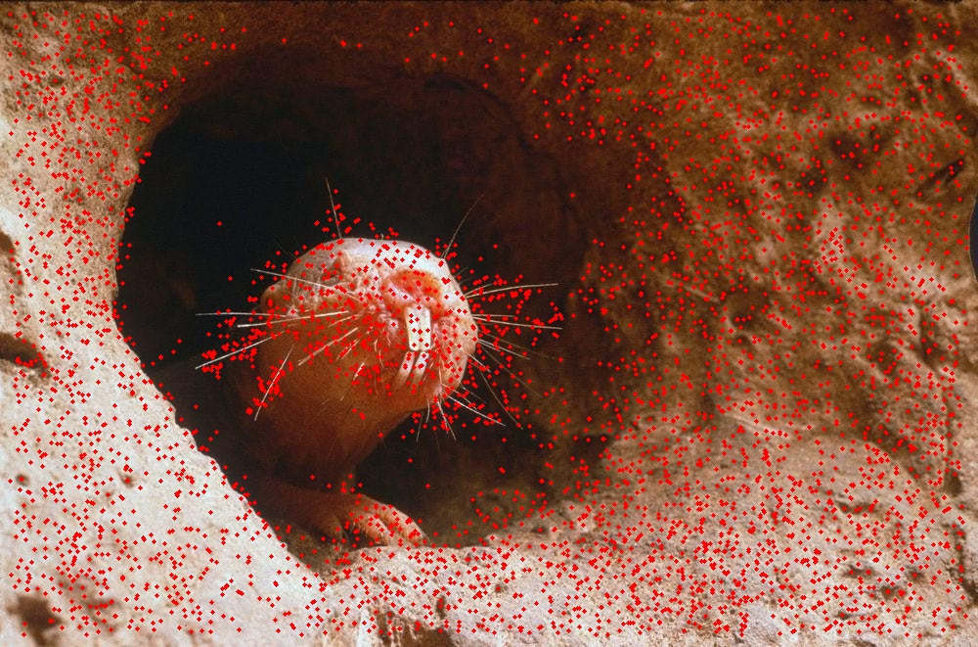
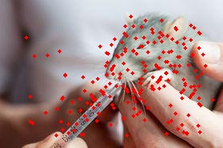
Hard and easy classes

Slide 11
Other models we tried
CRLR one vs all
CR softmax
MLP
feature reweighting
Sample reweighting
Joint prediction of class and context
Assign features to context or class
Genetic algorithm

Slide 12
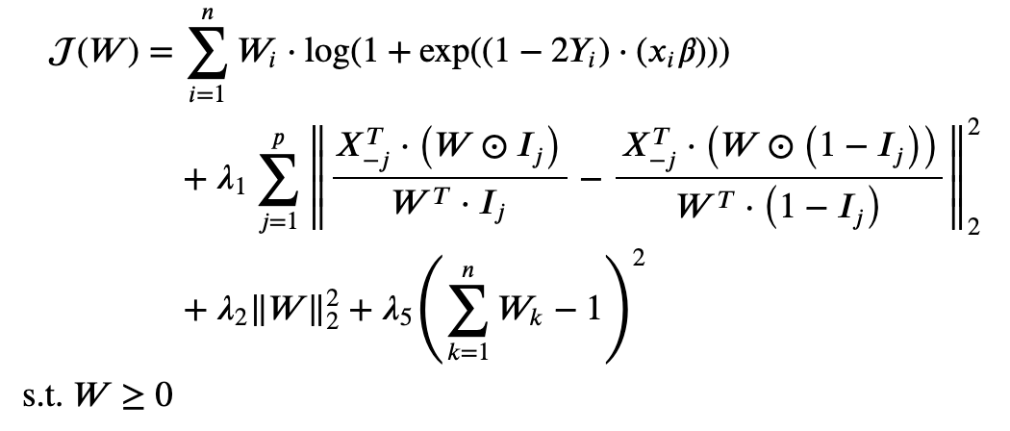
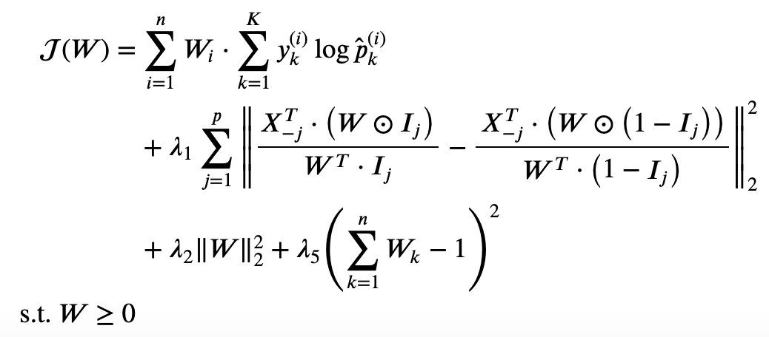
Causal regularized classification
CR Logistic Regression
CR Softmax Regression
Expand beta from [feature_num*1] to [feature_num*class_num]
One hot encoding class labels
Hard to optimize

Slide 13
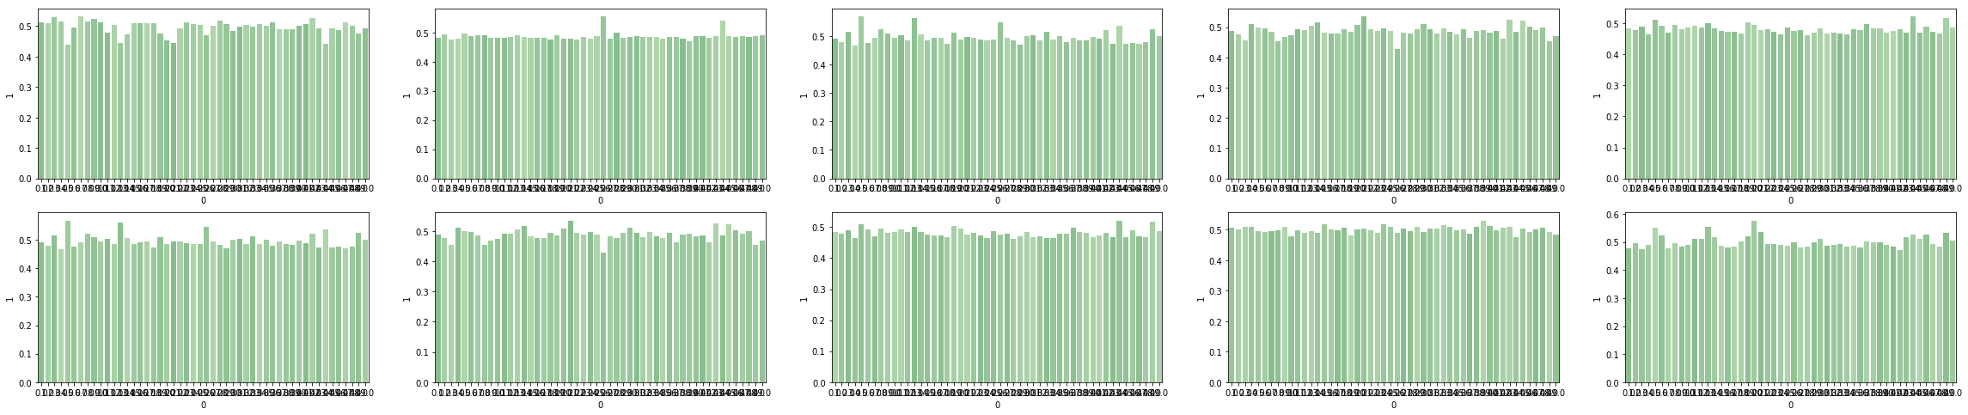
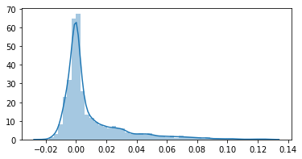
Parameters change a little

Slide 14
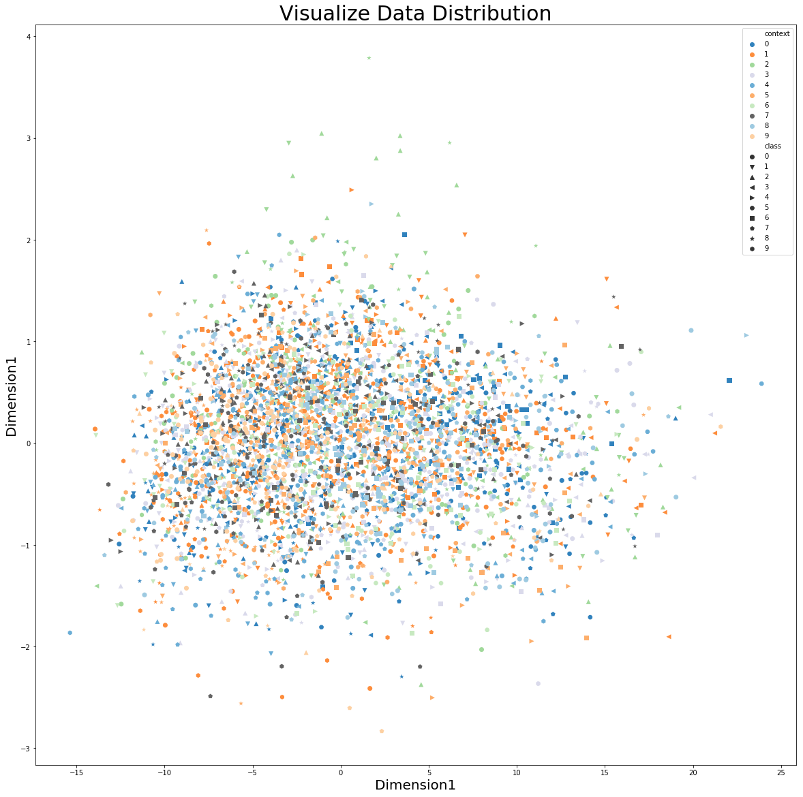
RUVs to remove batch: fail
UCA: 0.142

Slide 15
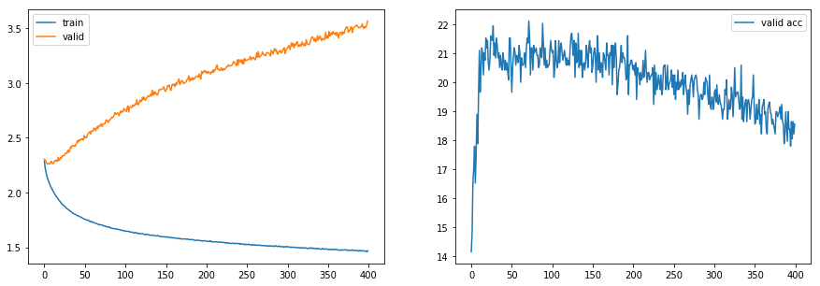
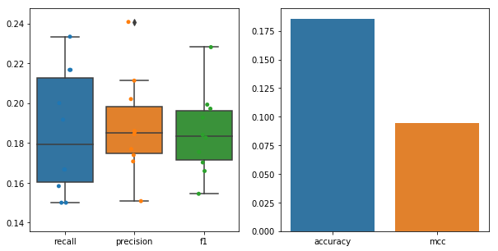
MLP simple

Slide 16
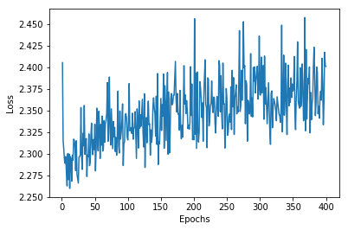
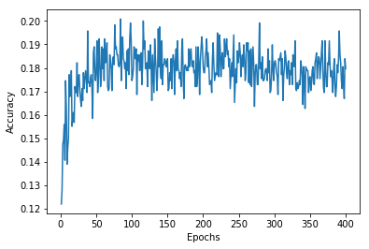
Feature reweighting

Slide 17
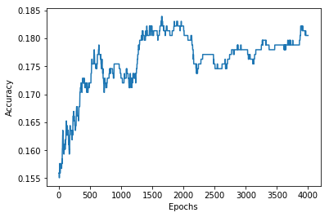
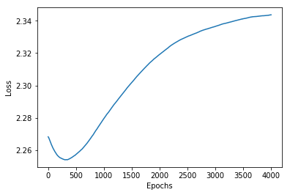
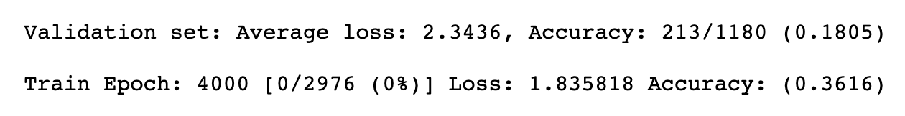
Sample reweighting
Overfitting?

Slide 18
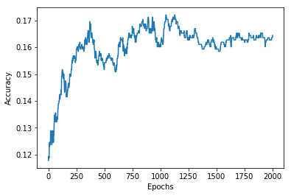
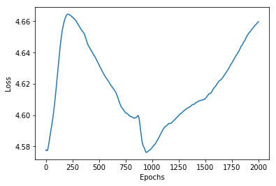
Joint prediction of class and context

Slide 19
Assign features to context or class
Inspired by CRLR paper
Assume the features of data can be split into one of the following four cases
Only contribute to obj classification
Only contribute to bgd classification
Contribute to both obj and bgd classification
Noise
What we need to do is finding those features which contribute to obj classification

Slide 20
Assign features to context or class
01 Sequence
1 : keep the feature corresponding 1’s position
0 : discard the feature corresponding to 0’s position
011001
Original Sample : 8 3 4 9 1 0
New Sample : 3 4 0

Slide 21
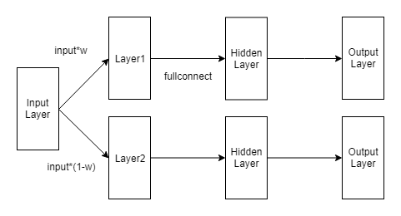
Network

Slide 22
Neural Network
To truncate w in range [0,1], we use sigmoid function
Loss function

Slide 23
Problem
Not Converge

Slide 24
Genetic Algorithm
Gene : 01 sequence
Adaptation Function : Decision Tree, 5 partition
1000 generations, 100 individuals per generation

Slide 25
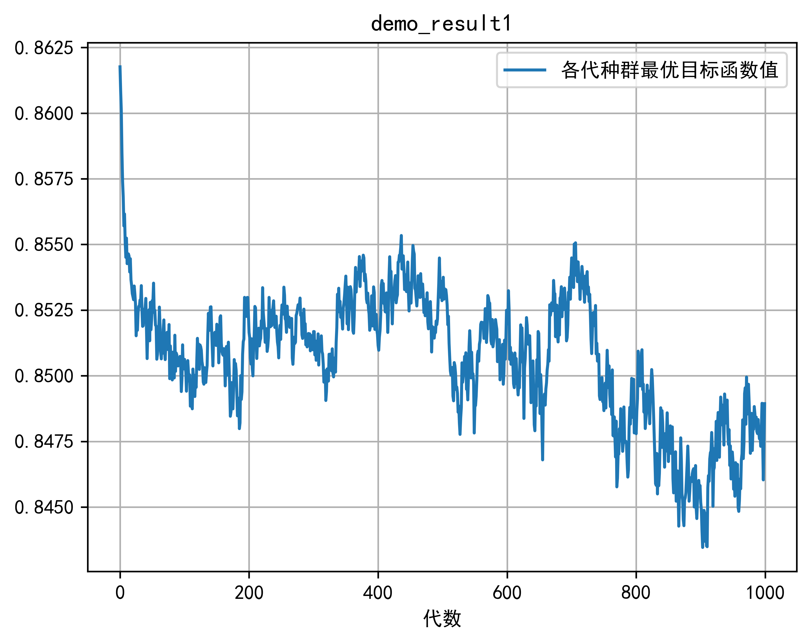
Problem
Converge, but too slow
About 8 hours
Instable
Overfit to the partition : 23.5% v.s. 15.5%

Slide 26
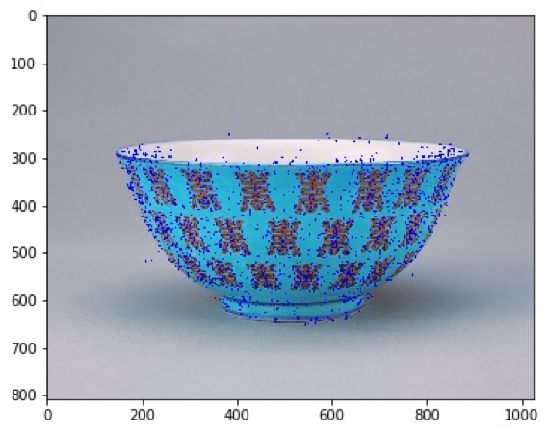
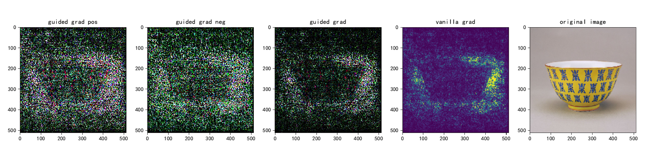
Thought: BoW made it hard to predict
BoW features and DL model features (another dataset)

Slide 27
Confounder removal or feature selection?
Sample reweighting, feature selection, confounder removal do not work well
It is more like a feature selection problem rather than confounder removal?
It’s hard to remove confounders if we do not provide “treatment” or “batch info”
“Confounders” may be useful. It’s hard to tell if the model use obj info or bkg info, so it’s hard to quantify the removal effect.
We may need a model to select different features for different sample, but the sample size is not enough to train a model
Notes:
这不像去除批次效应或者confounder的问题，如果最终目标是提高准确率的话，很难说用到background信息好还是不好，比如利用背景信息一个深度学习模型可以确认雪地里的那个动物大概率是狼而不是哈士奇。所以真的是靠去除confounder吗，感觉并不好说。

Slide 28
THANK YOU!

